Slide 1
An Energy-Harvesting Sensor Architecture and Toolkit for Building Monitoring and Event Detection
Brad Campbell and Prabal Dutta
University of Michigan
BuildSys’14 – November 6, 2014

Slide 2
Buildings must become more efficient while maintaining occupant comfort
Buildings represent 39% of the energy use in the U.S. and we spend 90% of our time indoors.
Goals: reduce energy consumption improve occupant comfort

Slide 3
BuildSys work targets the energy and comfort issues
Energy
Comfort
Models
Algorithms
Occupancy Context
Sensing [BuildSys’14]
Room-Level
Thermal Control [BuildSys’13]
MCC HVAC Fault Detection [BuildSys’14]
Sensors
PresenceSense [BuildSys’14]
Fixture Assignment [BuildSys’14]
ZonePAC
[BuildSys’13]
Carrying My Environment [BuildSys’13]
Circulo [BuildSys’13]
Retail Energy Analysis [BuildSys’13]
BlueSentinel [BuildSys’14]
Energy-Water Nexus [BuildSys’13]
HVAC Predictive Control [BuildSys’13]
Models for Diagnosing Abnormal Energy Usage [BuildSys’13]
Observation
Datasets

Slide 4
These sensors are often not the focus and hard to scale to building-size
Current sensors
One-off designs
Tailored to a particular need
Used to demonstrate model
Ideal
Reusable and reconfigurable sensors
Easily scale to building-wide deployment

Slide 5
These sensors must be installable and scalable
Main limiting factors: size and power
 |  | Power
 |  | AC Mains | Battery
Size | Large
 | Small
 |  | Power
 |  | AC Mains | Battery | Energy- Harvesting
Size | Large
 | Small
Installable Scalable
Installable Scalable
Installable Scalable
Small, energy-harvesting sensors
N/A
Installable Scalable
Installable Scalable

Slide 6
Energy-harvesting sensors exist, but are typically single-purpose
DoubleDip
Water metering
Trinity
Airflow metering
Paul Martin, Zainul Charbiwala, and Mani Srivastava. 2012. DoubleDip: leveraging thermoelectric harvesting for low power monitoring of sporadic water use. SenSys '12
Feng Li, Tianyu Xiang, Zicheng Chi, Jun Luo, Lihua Tang, Liya Zhao, and Yaowen Yang. 2013. Powering indoor sensing with airflows: a trinity of energy harvesting, synchronous duty-cycling, and sensing. SenSys '13

Slide 7
An architecture for energy-harvesting sensors can ease development
Data Communication
Log or transmit data wirelessly
Sensor
Optional dedicated sensor
Trigger
Wake-up mechanism
Energy-Harvesting Power Supply
Harvester for any energy source

Slide 8
The energy-harvesting power supply defines many operational parameters
Architecture is harvester agnostic
Solar, piezoelectric, thermoelectric, electromagnetic, etc.
Defines maximum duty cycle
Intermittent versus continuous
Interface:
Trigger
Shutdown
Data Communication
VCC
Sensor
Energy-Harvesting Power Supply
Trigger
Energy-Harvesting Power Supply

Slide 9
The trigger layer masks the intermittency inherit in energy-harvesting
Key: just need sufficient energy when an event occurs
activation threshold
Energy Harvested
triggered event occurs
Time
Variable, unpredictable harvesting
Waiting for event
Data Communication
Triggers:
Periodic – regular intervals
Opportunistic – when sufficient energy
Event based – external event occurs
Sensor
Trigger
Energy-Harvesting Power Supply

Slide 10
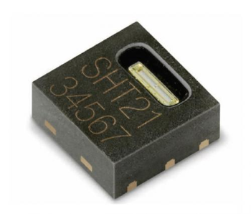
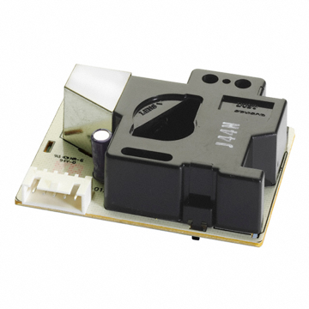
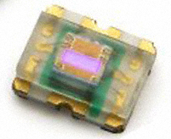
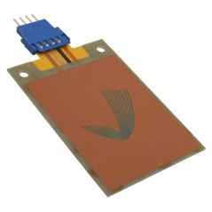
The optional sensing layer allows for common sensors to be sampled
Ideal: Sensors with short power-on to valid sample time
Trigger may be sufficient
To determine when energy is being harvested
To detect an event
Data Communication
Sensor
Trigger
Energy-Harvesting Power Supply

Slide 11

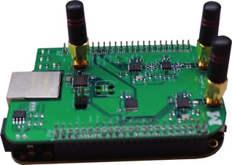
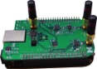

The data communication layer stores or forwards data
Single hop communication
Local logging
device collection
Data Communication
Network connectivity provided by gateways or other nodes
Possible offloading via Bluetooth to phones
Highly reusable
Sensor
Trigger
Energy-Harvesting Power Supply

Slide 12
Revisiting the prior energy-harvesting designs
DoubleDip
Power supply: thermoelectric generator
Trigger: event based, spike on harvester
Sensor: accelerometer
Data communication: immediate and batching
Trinity
Power supply: piezoelectric
Trigger: periodic
Sensor: piezoelectric airflow
Data communication: immediate
Paul Martin, Zainul Charbiwala, and Mani Srivastava. 2012. DoubleDip: leveraging thermoelectric harvesting for low power monitoring of sporadic water use. SenSys '12
Feng Li, Tianyu Xiang, Zicheng Chi, Jun Luo, Lihua Tang, Liya Zhao, and Yaowen Yang. 2013. Powering indoor sensing with airflows: a trinity of energy harvesting, synchronous duty-cycling, and sensing. SenSys '13

Slide 13
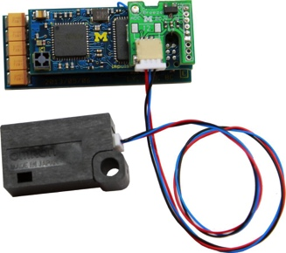
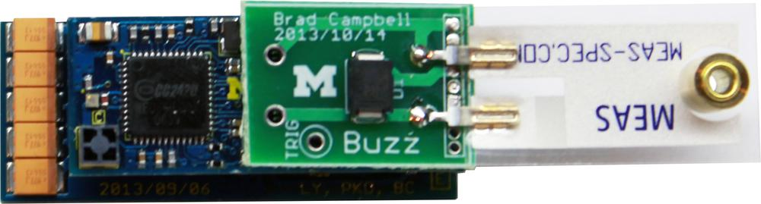
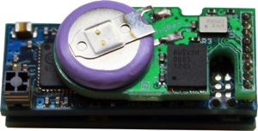

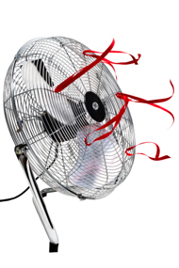

To validate this architecture, we implemented three new sensors with reusable components
Buzz
Breeze
BigBen

Slide 14
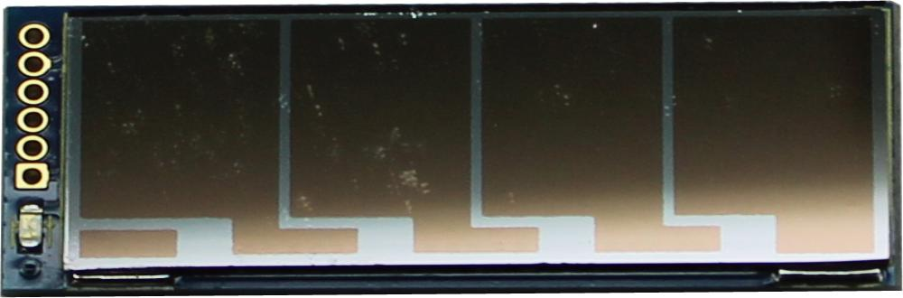
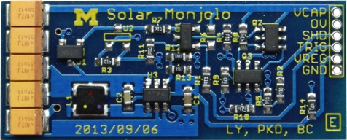
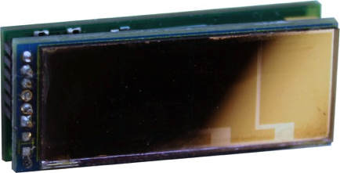
Power Supply: Indoor photovoltaic based harvester
1.5 cm
5.8 cm²
3.8 cm
Shared harvester that is useful for indoor sensing
When people are around, the lights are typically on
Provides trigger and shutdown interface
In reasonable lighting, charged every two minutes

Slide 15
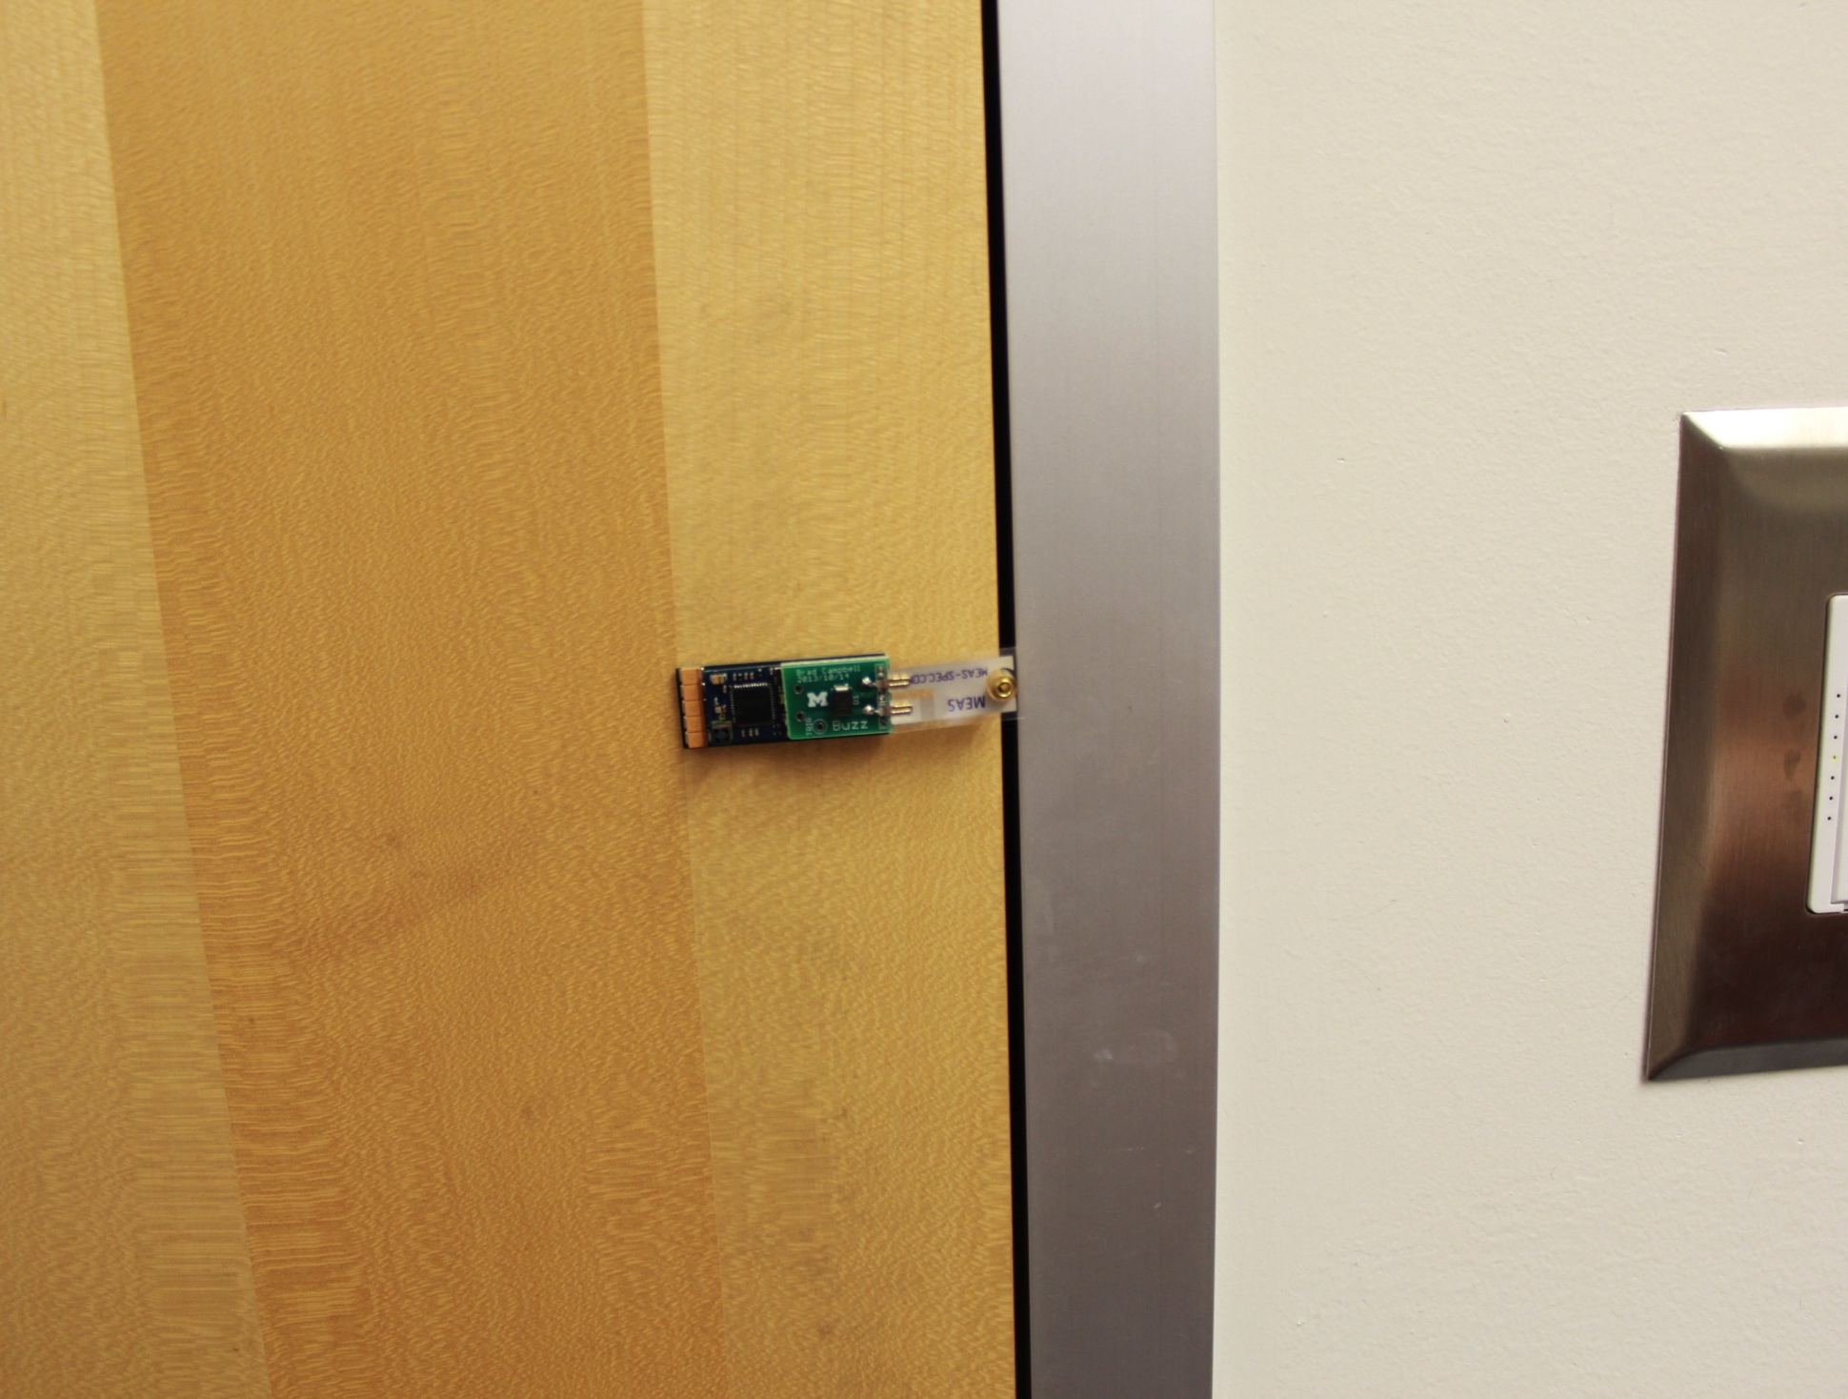
Buzz: A vibration sensor
Trigger: Piezoelectric event detector
Sensor: Event-based from trigger
Communication: Packet on event detection
Door event detection:
60% detection rate

Slide 16
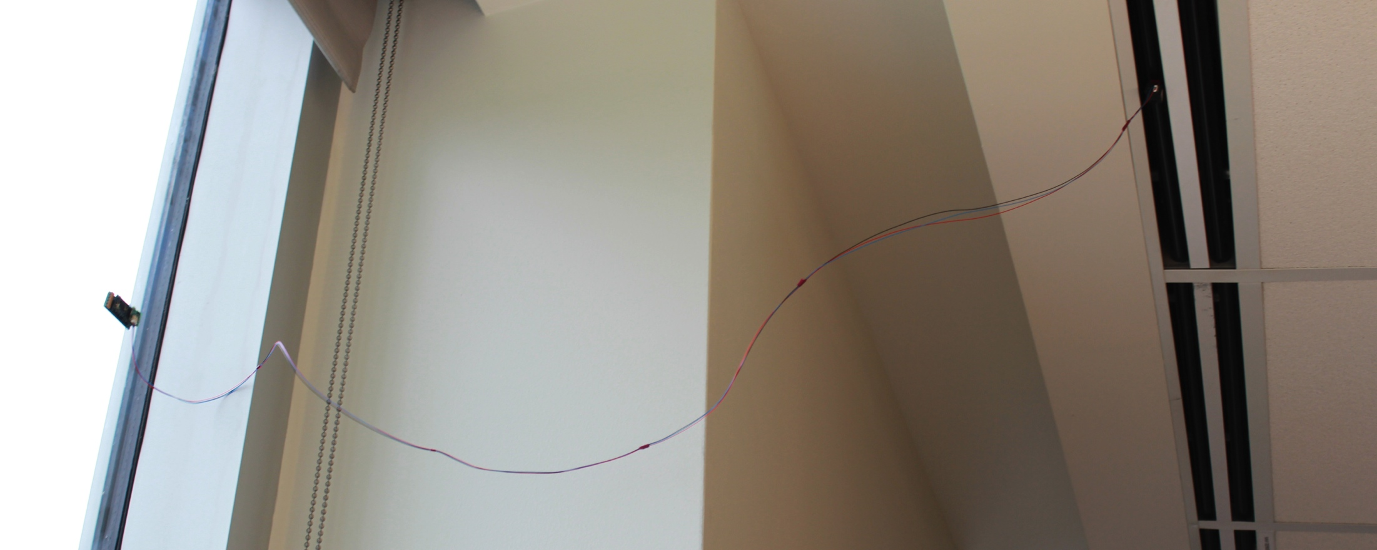
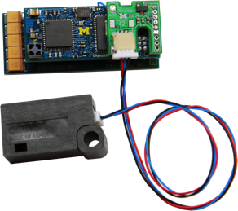
Breeze: An airflow sensor
Trigger: Opportunistic when energy available
Sensor: MEMS airflow meter
Communication: Packet on sample
Airflow detection:
Can detect air vent state changes

Slide 17
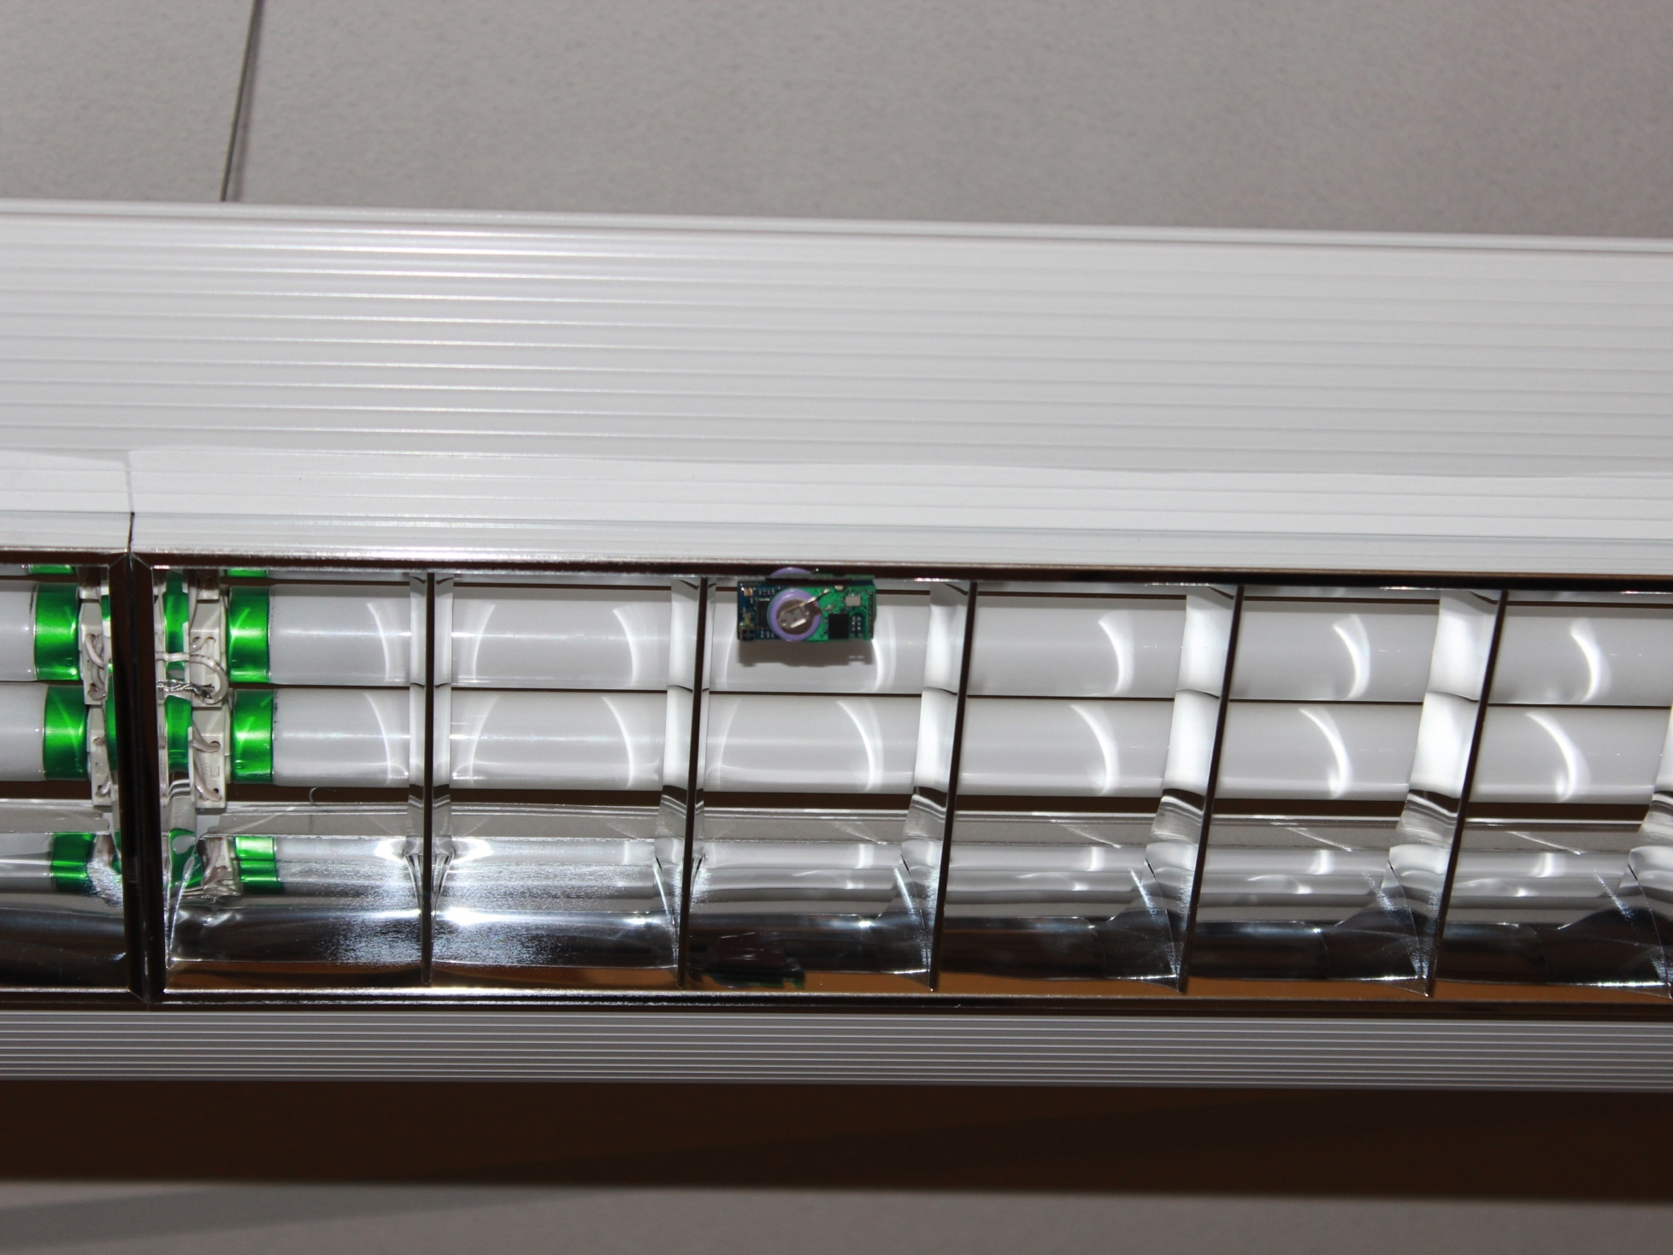
BigBen: A local-logging light sensor
Trigger: Opportunistic when energy available
Sensor: None
Communication: Log light state changes in FRAM
Additional: RTC with small battery
Light state detection:
Light state detection shifted 40 seconds

Slide 18
Conclusion: Architecture for creating energy-harvesting sensors
Leverage energy-harvesting to eliminate sensor maintenance
Mask intermittency by waiting for a trigger
Compose hardware layers to build a range of sensors
Address the sensor scaling issue

Slide 19

Questions?
Brad Campbell
bradjc@umich.edu
github.com/lab11
University of Michigan

